Slide 1
MOBILE COMMUNICATION
WIRELESS TRANSMISSION

Slide 2
2. Wireless transmission
Whiletransmissionoverdifferentwirestypicallydoesnotcause
interference, this is an important topic in wireless transmission.
The frequencies used for transmission are all regulated.
Multiplexing is a major design topic in this context, because the medium is always shared. Multiplexing schemes have to ensure low interference between different senders.
Modulation is needed to transmit digital data via certain frequencies.
Spreadspectrum,aspecialtransmissiontechniquethatismore
robust against errors.

Slide 3
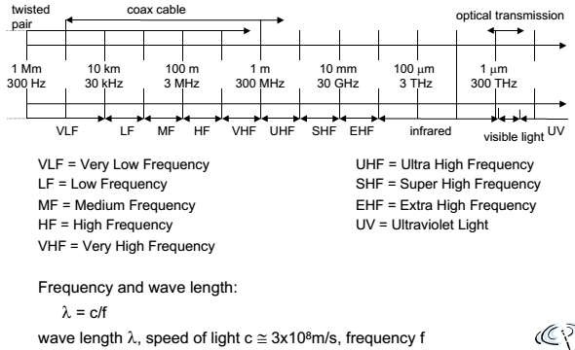
2.1. Frequencies for radio transmission

Slide 4
2.1. Frequencies for radio transmission
Radio transmission can take place using many different frequency
bands. For traditional wired networks,
frequencies of up to several hundred kHz are used for distances up to some km with twisted pair copper wires,
while frequencies of several hundred MHz are used with coaxial
cable.
Fiber optics are used for frequency ranges of several hundred THz.
Radio transmission starts at several kHz, the very low frequency
(VLF) range. These are very long waves.
Waves in the low frequency (LF) range are used by submarines, because they can penetrate water and can follow the earth’s surface.
Some radio stations still use these frequencies, e.g., between 148.5 kHz and 283.5 kHz in Germany.

Slide 5
2.1. Frequencies for radio transmission
The medium frequency (MF) and high frequency (HF) ranges are
typical for transmission of hundreds of radio stations either
asamplitudemodulation(AM)between520kHzand1605.5 kHz,
as short wave (SW) between 5.9 MHz and 26.1 MHz, or
as frequency modulation (FM) between 87.5 MHz and 108 MHz.
The frequencies limiting these ranges are typically fixed by national regulation and, vary from country to country.
Shortwavesaretypicallyusedfor(amateur)radiotransmission
around the world, enabled by reflection at the ionosphere.
Transmit power is up to 500 kW – which is quite high compared to the 1 W of a mobile phone.

Slide 6
2.1. Frequencies for radio transmission
As we move to higher frequencies, the TV stations follow.
Conventional analog TV is transmitted in ranges of 174–230 MHz and 470–790 MHz using the very high frequency (VHF) and ultra high frequency (UHF) bands.
In this range, digital audio broadcasting (DAB) takes place as well (223–230 MHz and 1452–1472 MHz) and digital TV is planned or currently being installed (470– 862 MHz), reusing some of the old frequencies for analog TV.
UHF is also used for mobile phones with analog technology (450–
465 MHz),
– The digital GSM (890–960 MHz, 1710–1880 MHz),
Digital cordless telephones following the DECT standard (1880– 1900 MHz),
3G cellular systems following the UMTS standard (1900–1980
MHz, 2020–2025 MHz, 2110–2190 MHz) and many more.

Slide 7
2.1. Frequencies for radio transmission
VHF and especially UHF allow for small antennas and relatively
reliable connections for mobile telephony.
Super high frequencies (SHF) are typically used for directed microwave links (approx. 2–40 GHz) and fixed satellite services in the C-band (4 and 6 GHz), Ku-band (11 and 14 GHz), or Ka-band (19 and 29 GHz).
Some systems are planned in the extremely high frequency(EHF)
range which comes close to infra red.
All radio frequencies are regulated to avoid interference, e.g., the
German regulation covers 9 kHz–275 GHz.

Slide 8
2.1. Frequencies for radio transmission
The next step into higher frequencies involves optical transmission, which is not only used for fiber optical links but also for wireless communications.
Infra red (IR) transmission is used for directed links, e.g., to
connect different buildings via laser links.
The most widespread IR technology, infra red data association (IrDA), uses wavelengths of approximately 850–900 nm to connect laptops, PDAs etc.
Finally, visible light has been used for wireless transmission for
thousands of years.
While light is not very reliable due to interference, but it is nevertheless useful due to built-in human receivers.

Slide 9
2.1. Frequencies for radio transmission
Regulations
Radio frequencies are scarce resources. Many national (economic) interests make it hard to find common, worldwide regulations.
The International Telecommunications Union (ITU) located in Geneva is responsible for worldwide coordination of telecommunication activities (wired and wireless).
ITU is a sub- organization of the UN.
handles
handles
– The ITU Radio communication sector (ITU-R) standardization in the wireless sector, so it also frequency planning.

Slide 10
2.1. Frequencies for radio transmission
To have at least some success in worldwide coordination and to reflect national interests, the ITU-R has split the world into three regions:
Region1coversEurope,theMiddleEast,countriesofthe former Soviet Union, and Africa.
Region 2 includes Greenland, North and South America, and
Region 3 comprises the Far East, Australia, and New Zealand.
Within these regions, national agencies are responsible for further regulations, e.g., the Federal Communications Commission (FCC) in the US.
Several nations have a common agency such as European Conference for Posts and Telecommunications (CEPT) in Europe.
To achieve at least some harmonization, the ITU-R holds, the World Radio Conference (WRC), to periodically discuss and decide frequency allocations for all three regions.

Slide 11
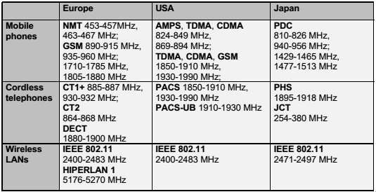

2.1. Frequencies for radio transmission

Slide 12
2.2. Signals
Signals are the physical representation of data.
Users of a communication system can only exchange data through the transmission of signals.
Layer 1 of the ISO/OSI basic reference model is responsible for the conversion of data, i.e., bits, into signals and vice versa.
Signals are functions of time and location.
Signal parameters represent the data values.
Themostinterestingtypesofsignalsforradiotransmissionare
periodic signals, especially sine waves as carriers.
The general function of a sine wave is,
g( t )=A_{t} sin ( 2 πf_{t} t +φ_{t} )
SignalparametersaretheamplitudeA,thefrequencyf,andthe
phase shift φ.

Slide 13

2.2. Signals
Sine waves are of special interest, as it is possible to construct every periodic signal g by using only sine and cosine functions according to a fundamental equation of Fourier :
?
In this equation the parameter c determines the Direct Current
(DC) component of the signal.
The coefficients a_{n} and b_{n} are the amplitudes of the n^{th} sine and cosine function.
Theequationshowsthataninfinitenumberofsineandcosine
functions is needed to construct arbitrary periodic functions.
The bandwidth of any medium, air, cable, transmitter etc. is limited and, there is an upper limit for the frequencies.

Slide 14
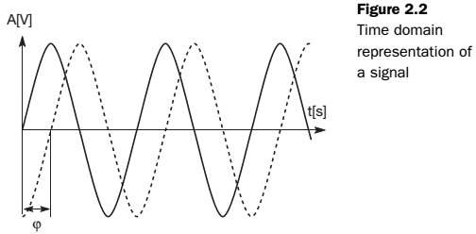
2.2. Signals
A typical way to represent signals is the time domain.
Here the amplitude A of a signal is shown versus time.
Representationsinthetimedomainareproblematicifasignal consists of many different frequencies.

Slide 15
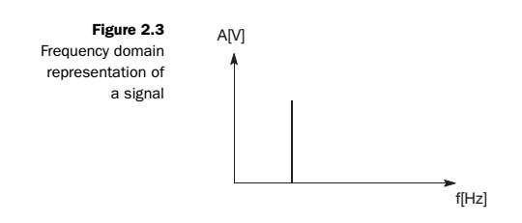
2.2. Signals
Inthiscase,abetterrepresentationofasignalisthefrequency
domain.
Here the amplitude of a certain frequency part of the signal is shown versus the frequency.
Figure 2.3 only shows one peak and the signal consists only of a
single frequency part (i.e., it is a single sine function).
Arbitrary periodic functions would have many peaks, known as the
frequency spectrum of a signal.
A tool to display frequencies is a
spectrum analyzer.

Slide 16
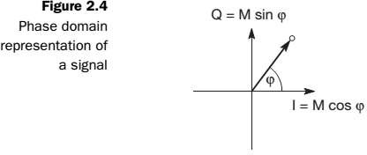
2.2. Signals
A third way to represent signals is thephase domain shown.
This representation, also called phase state, shows the amplitude M of a signal and its phase φ in polar coordinates.
The x-axis represents a phase of 0 and is also called In-Phase ( I ).
A phase shift of 90° or π/2 would be a point on the y-axis, called
Quadrature ( Q ).

Slide 17
2.3.Antennas
As the name wireless already indicates, this communication mode involves ‘getting rid’ of wires and transmitting signals through space without guidance.
We do not need any ‘medium’ (such as an ether) for the transport of
electromagnetic waves.
Somehow, we have to couple the energy from the transmitter to the out side world and, in reverse, from the outside world to the receiver. This is exactly what antennas do.
Antennas couple electromagnetic energy to and from space to and
from a wire or coaxial cable (or any other appropriate conductor).

Slide 18
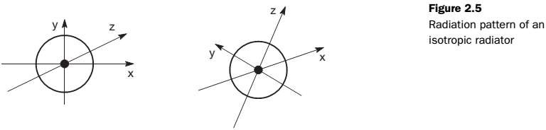
2.3.Antennas
A theoretical reference antenna is the isotropic radiator,
– a point in space radiating equal power in all directions, i.e., all points with equal power are located on a sphere with the antenna as its center.
The radiation pattern is symmetric in all directions.
However, such an antenna does not exist in reality.
Realantennasallexhibitdirectiveeffects,i.e.,theintensityof
radiation is not the same in all directions from the antenna.

Slide 19
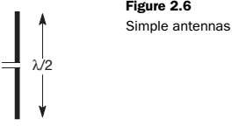

2.3.Antennas
The simplest real antenna is a thin, center-fed dipole, also called
Hertzian dipole.
The dipole consists of two collinear conductors of equal length, separated by a small feeding gap.
The length of the dipole is not arbitrary, but, for example, half the wavelength λ of the signal to transmit results in a very efficient radiation of the energy.
If mounted on the roof of a car, the length of λ/4 is efficient. This is also known as Marconi antenna.

Slide 20
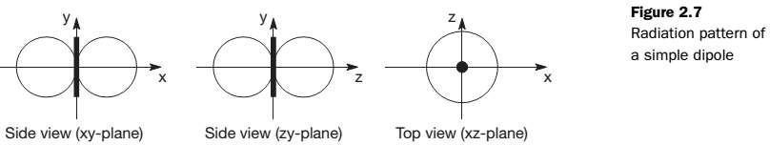
2.3.Antennas
A λ/2 dipole has a uniform or omni-directional radiation pattern in
one plane and a figure eight pattern in the other two planes.
This type of antenna can only overcome environmental challenges by boosting the power level of the signal.
–Challenges could be mountains, valleys, buildings etc.

Slide 21
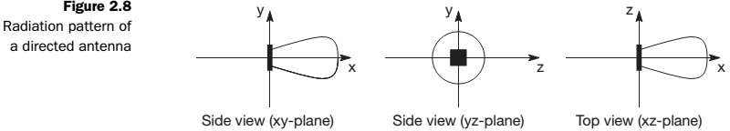
2.3.Antennas
If an antenna is positioned, e.g., in a valley or between buildings, an
omnidirectional radiation pattern is not very useful.
Inthiscase,directionalantennaswithcertainfixedpreferential transmission and reception directions can be used.
Figure 2.8 shows the radiation pattern of a directional antenna with
the main lobe in the direction of the x-axis.
A special example of directional antennas is constituted by satellite
dishes.

Slide 22
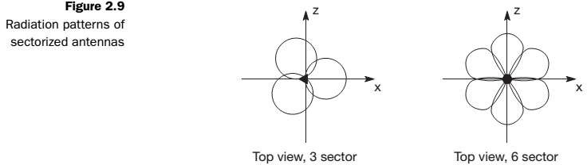
2.3. Antennas
Directed antennas are typically applied in cellular systems.
Severaldirectedantennascanbecombinedonasinglepoleto construct a sectorized antenna.
A cell can be sectorized into, for example, three or six sectors, thus
enabling frequency reuse.
Figure 2.9 shows the radiation patterns of these sectorized antennas.

Slide 23
2.3.Antennas
Two or more antennas can also be combined to improve reception
by counteracting the negative effects of multi-path propagation.
These antennas, also called multi-element antenna arrays, allow different diversity schemes.
One such scheme is switched diversity or selection diversity, where the receiver always uses the antenna element with the largest output.
Diversity combining constitutes a combination of the power of all
signals to produce gain.
The phase is first corrected (co-phasing) to avoid cancellation.

Slide 24
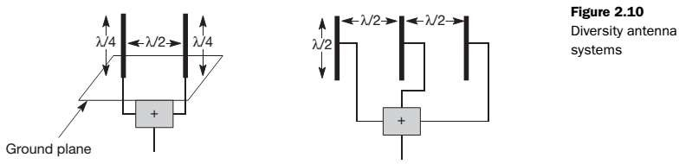
2.3.Antennas
As shown in Figure 2.10, different schemes are possible.
On the left, two λ/4 antennas are combined with a distance of λ/2
between them on top of a ground plane.
On the right, three standard λ/2 dipoles are combined with a distance of λ/2 between them.
Spacing could also be in multiples of λ/2.

Slide 25
2.3. Antennas
A more advanced solution is provided by smart antennas
– which combine multiple antenna elements (also called antenna array) with signal processing to optimize the radiation/reception pattern in response to the signal environment.
These antennas can adapt to changes in reception power, transmission conditions and many signal propagation effects.
Today’s handset antennas are omni-directional as the integration of smart antennas into mobiles is difficult and has not yet been realized.

Slide 26
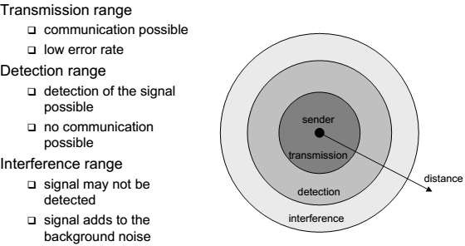
2.4. Signal propagation
Signal propagation ranges

Slide 27
2.4. Signal propagation
2.4.1. Path loss of radio signals
In free space radio signals propagate as light does, i.e., they follow a straight line.
If such a straight line exists between a sender and a receiver it is
called line-of-sight (LOS).
Even if no matter exists between the sender and the receiver (i.e., if there is a vacuum), the signal still experiences the free space loss.
ThereceivedpowerP_{r}isproportionalto1/d²withdbeingthe
distance between sender and receiver (inverse square law).
Evenwithoutanymatterbetweensenderandreceiver,additional parameters are important.
–The received power also depends on the wavelength and the gain
of receiver and transmitter antennas.

Slide 28
2.4. Signal propagation
Most radio transmission takes place through the atmosphere
–signals travel through air, rain, snow, fog, dust particles, smog
etc.
While the path loss or attenuation does not cause too much trouble for short distances, e.g., for LANs,
The atmosphere heavily influences transmission over long distances,
e.g., satellite transmission.
Even mobile phone systems are influenced by weather conditions such as heavy rain.
Rain can absorb much of the radiated energy of the antenna (this effect is used in a microwave oven to cook), so communication links may break down as soon as the rain sets in.
Depending on the frequency, radio waves can also penetrate objects.
Generally the lower the frequency, the better the penetration.

Slide 29
2.4. Signal propagation
Radio waves can exhibit three fundamental propagation behaviors depending
on their frequency :
Ground wave ( < 2 MHz ) :
Waveswithlowfrequenciesfollowtheearth’ssurfaceandcan propagate long distances.
These waves are used for, e.g., submarine communication or AM radio.
Sky wave ( 2 – 30 MHz ) :
Many international broadcasts and amateur radio use these short waves that are reflected at the ionosphere.
This way the waves can bounce back and forth between theionosphere
and the earth’s surface, travelling around the world.
Line-of-sight ( > 30 MHz ) :
Mobile phone systems, satellite systems, cordless telephones etc. use even higher frequencies. The emitted waves follow a straight line of sight. This enables direct communication with satellites or microwave links on the ground.

Slide 30
2.4. Signal propagation
2.4.2 Additional signal propagation effects
signal propagation in free space almost follows a straight line, like light.
But in real life, we rarely have a line-of-sight between the sender
and receiver of radio signals.
Mobile phones are typically used in big cities with skyscrapers, on mountains, inside buildings, while driving through an alley etc.
Here several effects occur in addition to the attenuation caused by the distance between sender and receiver, which are again very much frequency dependent.

Slide 31
2.4. Signal propagation
An extreme form of attenuation is blocking or shadowing of radio
signals due to large obstacles.
The higher the frequency of a signal, the more it behaves like light. Even small obstacles like a simple wall, a truck on the street, or trees in an alley may block the signal.
Another effect is the reflection of signals. If an object is large compared to the wavelength of the signal, e.g., huge buildings, mountains, or the surface of the earth, the signal is reflected.
The reflected signal is not as strong as the original, as objects
can absorb some of the signal’s power.
Reflection helps transmitting signals as soon as no LOS exists.
Signals transmitted from a sender may bounce off the walls of buildings several times before they reach the receiver.
The more often the signal is reflected, the weaker it becomes.

Slide 32
2.4. Signal propagation
Refraction effect occurs because the velocity of the electromagnetic waves depends on the density of the medium through which it travels.
If the size of an obstacle is in the order of the wavelength or less, then waves can be scattered.
– An incoming signal is scattered into several weaker outgoing signals.
Diffraction effect is very similar to scattering. Radio waves will be deflected at an edge and propagate in different directions.
Theresultofscatteringanddiffractionarepatternswithvarying signal strengths depending on the location of the receiver.
Effectslikeattenuation,scattering,diffraction,andrefractionall happen simultaneously and are frequency and time dependent.

Slide 33
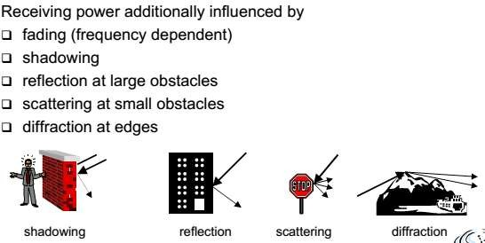
2.4. Signal propagation

Slide 34
2.4. Signal propagation
2.4.3 Multi-path propagation
Due to the finite speed of light, signals travelling along different paths with different lengths arrive at the receiver at different times.
Thiseffect(causedbymulti-pathpropagation)iscalleddelay
spread.
–The original signal is spread due to different delays of parts of the signal.
The effect of this delay spread on the signals representing the data is that a short impulse will be smeared out into a broader impulse, or rather into several weaker impulses.

Slide 35
2.4. Signal propagation
Now consider on the sender side, both impulses are separated.
At the receiver, both impulses interfere, i.e., they overlap in time.
Now consider that each impulse should represent a symbol, and that one or several symbols could represent a bit.
The energy intended for one symbol now spills over to the adjacent
symbol, an effect which is called inter symbol interference (ISI).
The higher the symbol rate to be transmitted, the worse the effects of ISI will be, as the original symbols are moved closer and closer to each other.
ISI limits the bandwidth of a radio channel with multi-path propagation

Slide 36
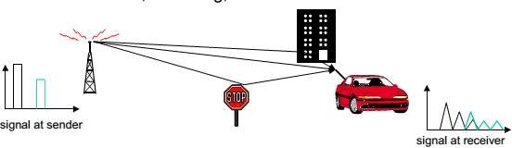
2.4. Signal propagation

Slide 37
2.4. Signal propagation
While ISI and delay spread already occur in the case of fixed radio transmitters and receivers, the situation is even worse if receivers, or senders, or both, move.
Then the channel characteristics change over time, and the paths a
signal can travel along vary.
This effect is well known (and audible) with analog radios while driving.
The power of the received signal changes considerably over time.
These quick changes in the received power are also called short-
term fading.
Depending on the different paths the signals take, these signals may have a different phase and cancel each other.

Slide 38
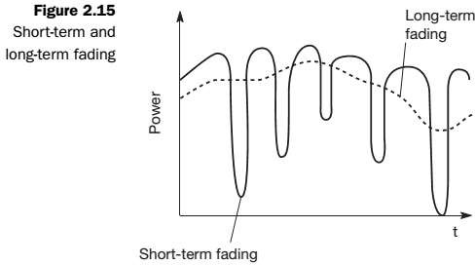
2.4. Signal propagation
long-term fading has the average power over time, is caused by, for
example, varying distance to the sender or more remote obstacles.
Typically, senders can compensate for long-term fading by increasing/decreasing sending power so that the received signal always stays within certain limits.

Slide 39
2.5. Multiplexing
Multiplexing describes how several users can share a medium with
minimum or no interference.
One example, is highways with several lanes.
For wireless communication, multiplexing can be carried out in four dimensions :
space
time
frequency and
code
In this field, the task of multiplexing is to assign space, time, frequency, and code to each communication channel with a minimum of interference and a maximum of medium utilization.
The term communication channel here only refers to an association
of sender(s) and receiver(s) who want to exchange data.

Slide 40
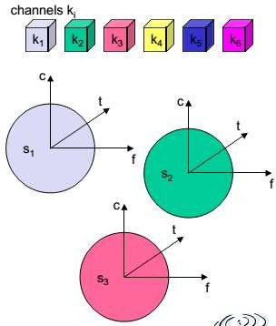
2.5. Multiplexing
2.5.1. Space division multiplexing
Figureshows six channels k_{i} and introduces a three dimensional coordinate system.
In space division multiplexing (SDM), the space s_{i} is also shown.
Here space is represented via
circles indicating the interference range
How is the separation of the different channels achieved?
The channels k₁ to k₃ can be mapped onto the three ‘spaces’ s₁ to s₃ which clearly separate the channels and prevent the interference ranges from overlapping.
.

Slide 41
2.5. Multiplexing
The space between the interference ranges is sometimes called guard space. Such a guard space is needed in all four multiplexing schemes presented.
For the remaining channels ( k₄ to k₆ ) three additional spaces would be needed.
Although this procedure clearly represents a waste of space, this is
exactly the principle used by the old analog telephone system :
– each subscriber is given a separate pair of copper wires to the local exchange.
SDM implies a separate sender for each communication channel
with a wide enough distance between senders.
This multiplexing scheme is used, for example, at FM radio stations where the transmission range is limited to a certain region.
Many radio stations around the world can use the same frequency
without interference.

Slide 42
2.5. Multiplexing
2.5.2 Frequency division multiplexing
Frequencydivisionmultiplexing(FDM)describes
schemesto
subdivide the frequency dimension into several non-overlapping frequency bands.
Each channel k_{i} is now allotted its own frequency band as indicated. Senders using a certain frequency band can use this band continuously.
Again, guard spaces are needed to avoid frequency band overlapping (also called adjacent channel interference).
This scheme is used for radio stations within the same region, where each radio station has its own frequency.
This very simple multiplexing scheme does not need complex coordination between sender and receiver: the receiver only has to tune in to the specific sender.

Slide 43
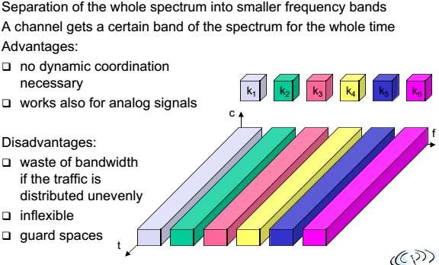
2.5. Multiplexing

Slide 44
2.5. Multiplexing
2.5.3 Time division multiplexing
In Time division multiplexing (TDM) a channel k_{i} is given the whole bandwidth for a certain amount of time, i.e., all senders use the same frequency but at different points in time.
Again, guard spaces, which now represent time gaps, have to
separate the different periods when the senders use the medium.
If two transmissions overlap in time, this is called co-channel interference.
To avoid this type of interference, precise synchronization between
different senders is necessary.

Slide 45
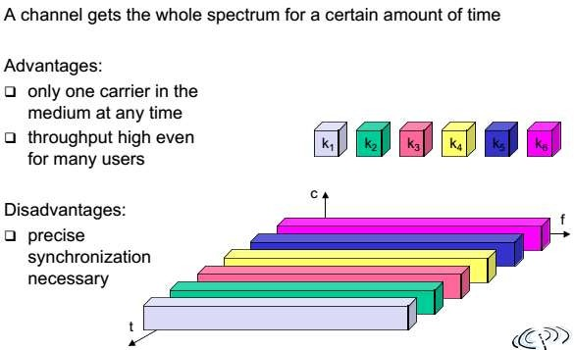
2.5. Multiplexing

Slide 46
2.5. Multiplexing
Frequency and time division multiplexing can be combined, i.e., a channel k_{i} can use a certain frequency band for a certain amount of time.
Now guard spaces are needed both in the time and in the frequency dimension.
This scheme is more robust against frequency selective interference,
i.e., interference in a certain small frequency band.
A channel may use this band only for a short period of time.
Additionally, this scheme provides some (weak) protection against tapping, as in this case the sequence of frequencies a sender uses has to be known to listen in to a channel.
A disadvantage of this scheme is again the necessary coordination between different senders.

Slide 47
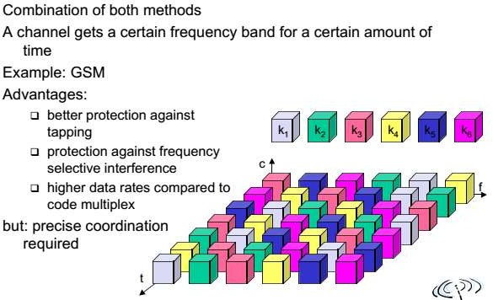
2.5. Multiplexing

Slide 48
2.5. Multiplexing
2.5.4 Code division multiplexing
In Code division multiplexing all channels k_{i} use the same frequency at the same time for transmission.
Separation is now achieved by assigning each channel its own ‘code’, guard spaces are realized by using codes with the necessary ‘distance’ in code space, e.g., orthogonal codes.
The main advantage of CDM for wireless transmission is that it gives good protection against interference and tapping.
Different codes have to be assigned, but code space is huge
compared to the frequency space.
Assigning individual codes to each sender does not usually cause problems.

Slide 49
2.5. Multiplexing
The main disadvantage of this scheme is the relatively high
complexity of the receiver.
A receiver has to know the code and must separate the channel with user data from the background noise composed of other signals and environmental noise.
Additionally, a receiver must be precisely synchronized with the transmitter to apply the decoding correctly.

Slide 50
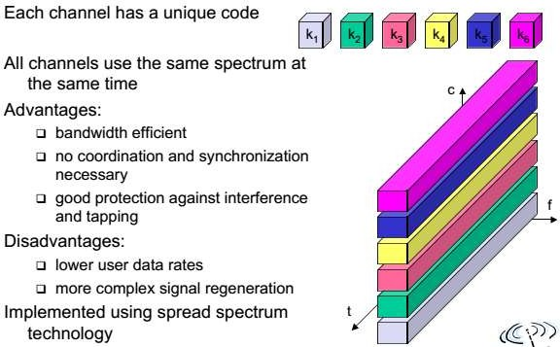
2.5. Multiplexing

Slide 51
2.6. Modulation
The basic function of a sine wave which already indicates the three
basic modulation schemes.
g( t )=A_{t} sin ( 2 πf_{t} t +φ_{t} )
This function has three parameters: amplitude A_{t}, frequency f_{t}, and phase φ_{t} which may be varied in accordance with data or another modulating signal.
For digital modulation, digital data (0 and 1) is translated into an analog signal ( baseband signal ).
Digital modulation is required if digital data has to be transmitted
over a medium that only allows for analog transmission.
One example for wired networks is the old analog telephone system.
– to connect a computer to this system a modem is needed. The modem then performs the translation of digital data into analog signals and vice versa.

Slide 52
2.6. Modulation
In wireless networks, however, digital transmission cannot be used.
Here, the binary bit-stream has to be translated into an analog signal
first.
The three basic methods for this translation are,
amplitude shift keying (ASK)
frequency shift keying (FSK) and
phase shift keying (PSK)
Apart from the translation of digital data into analog signals, wireless transmission requires an additional modulation, an analog modulation.
Analog modulation shifts the center frequency of the baseband
signal generated by the digital modulation up to the radio carrier.

Slide 53
2.6. Modulation
There are several reasons why this baseband signal cannot be
directly transmitted in a wireless system :
Antennas :
An antenna must be the order of magnitude of the signal’s wave length in size to be effective.
For the 1 MHz signal in the example this would result in an antenna some hundred meters high, which is obviously not very practical for handheld devices.
With 1 GHz, antennas a few centimeters in length can be used.
Frequency division multiplexing :
Using only baseband transmission, FDM could not be applied. Analog modulation shifts the baseband signals to different carrier frequencies.
The higher the carrier frequency, the more bandwidth that is
available for many baseband signals.

Slide 54
2.6. Modulation
Medium characteristics :
Path-loss,penetrationofobstacles,reflection,scattering,and diffraction depend heavily on the wavelength of the signal.
Depending on the application, the right carrier frequency with the desired characteristics has to be chosen.
long waves for submarines, short waves for handheld devices, very short waves for directed microwave transmission etc.
As for digital modulation, three different basic schemes are known
for analog modulation,
amplitude modulation (AM)
frequency modulation (FM) and
phase modulation (PM)

Slide 55
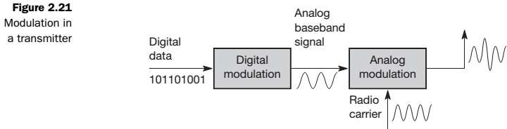
2.6. Modulation
Figure 2.21 shows a simplified block diagram of a radio transmitter
for digital data.
Thefirststepisthedigitalmodulationofdataintotheanalog
baseband signal.
The analog modulation then shifts the center frequency of the analog signal up to the radio carrier.
This signal is then transmitted via the antenna.

Slide 56
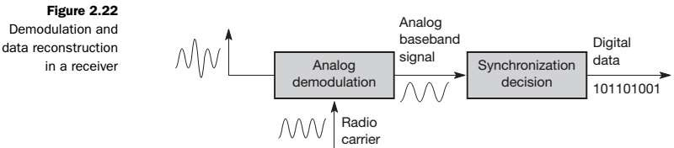
2.6. Modulation
The receiver receives the analog radio signal via its antenna and demodulates the signal into the analog baseband signal with the help of the known carrier.
This would be all that is needed for an analog radio tuned in to a radio station.
For digital data, another step is needed. Bits or frames have to be detected, i.e., the receiver must synchronize with the sender.
How synchronization is achieved, depends on the digital modulation scheme. After synchronization, the receiver has to decide if the signal represents a digital 1 or a 0, reconstructing the original data.

Slide 57
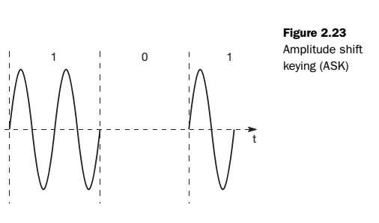
2.6. Modulation
2.6.1. Amplitude shift keying
Amplitude shift keying, the most simple digital modulation scheme.
The two binary values, 1 and 0, are represented
by two different amplitudes.
This simple scheme only requires low bandwidth, but is very susceptible
to interference.
Effects like multi-path propagation, noise, or path loss heavily influence the amplitude.
In a wireless environment, a constant amplitude cannot be guaranteed, so ASK is typically not used for wireless radio transmission.

Slide 58
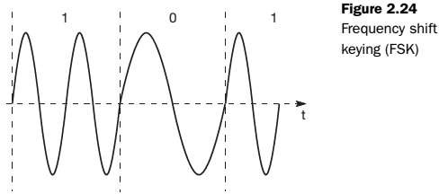
2.6. Modulation
2.6.2. Frequency shift keying
Amodulationschemeoftenusedforwirelesstransmissionis frequency shift keying.
The simplest form of FSK, also called binary FSK (BFSK), assigns one frequency f₁ to the binary 1 and another frequency f₂ to the binary 0.

Slide 59
2.6. Modulation
A very simple way to implement FSK is to switch between two oscillators, one with the frequency f₁ and the other with f₂, depending on the input.
To avoid sudden changes in phase, special frequency modulators with continuous phase modulation, (CPM) can be used.
Sudden changes in phase cause high frequencies, which is an
undesired side-effect.
A simple way to implement demodulationis by using two band pass filters, one for f₁ the other for f₂ .
Acomparatorcanthencomparethesignallevelsofthefilter outputs to decide which of them is stronger.
FSK needs a larger bandwidth compared to ASK but is much less susceptible to errors.

Slide 60
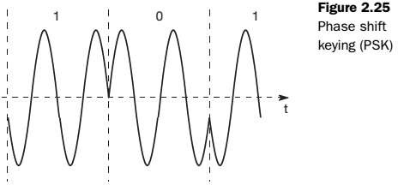
2.6. Modulation
2.6.3. Phase shift keying
Phase shift keying uses shifts in the phase of a signal to represent data. Figure 2.25 shows a phase shift of 180° or π as the 0 follows the 1 (the same happens as the 1 follows the 0).
This simple scheme,shifting the phase by 180° each time the value
of data changes, is also called binary PSK (BPSK).

Slide 61
2.6. Modulation
A simple implementation of a BPSK modulator could multiply a frequency f with +1 if the binary data is 1 and with –1 if the binary data is 0.
To receive the signal correctly, the receiver must synchronize in
frequency and phase with the transmitter.
This can be done using a phase lock loop (PLL).
Compared to FSK, PSK is more resistant to interference, but receiver and transmitter are also more complex.

Slide 62
2.6. Modulation
2.6.4. Advanced frequency shift keying
A famous FSK scheme used in many wireless systems is minimum shift keying (MSK).
MSKisbasicallyBFSKwithoutabruptphasechanges,i.e.,it
belongs to CPM schemes.
Figure 2.26 shows an example for the implementation of MSK.
In a first step, data bits are separated into even and odd bits, the duration of each bit being doubled.
The scheme also uses two frequencies,
f₁-the lower frequency and
f₂-the higher frequency, with f₂ = 2f₁.

Slide 63
2.6. Modulation
According to the following scheme, the lower or higher frequency is
chosen (either inverted or non-inverted) to generate the MSK signal,
if the even and the odd bit are both 0, then the higher frequency f₂ is inverted (i.e., f₂ is used with a phase shift of 180°).
if the even bit is 1, the odd bit 0, then the lower frequency f₁ is inverted.
iftheevenbitis0andtheoddbitis1,f₁istakenwithout changing the phase.
if both bits are 1 then the original f₂ is taken.
A high frequency is always chosen if even and odd bits are equal. The signal is inverted if the odd bit equals 0.
This scheme avoids all phase shifts in the resulting MSK signal.

Slide 64
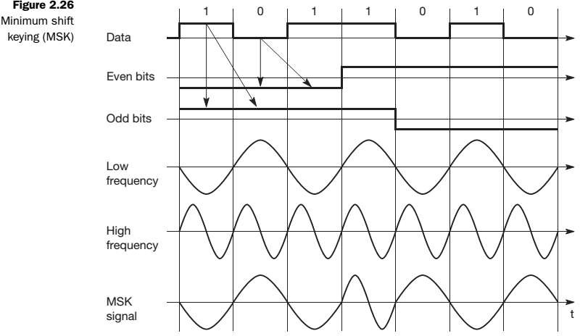
2.6. Modulation

Slide 65
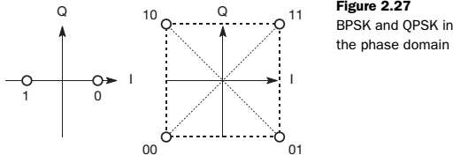
2.6. Modulation
2.6.5. Advanced phase shift keying
The simple PSK scheme can be improved in many ways. The basic
BPSK scheme only uses one possible phase shift of 180°.
The left side of Figure 2.27 shows BPSK in the phase domain.
The right side of Figure 2.27 shows quadrature PSK (QPSK), one
of the most common PSK schemes (also called quaternary PSK).
Here, higher bit rates can be achieved for the same bandwidth by coding two bits into one phase shift.
Alternatively, one can reduce the bandwidth and still achieve the
same bit rates as for BPSK.

Slide 66
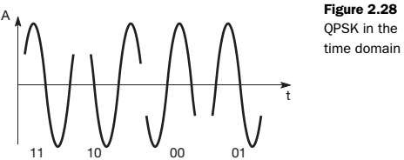
2.6. Modulation
QPSK (and other PSK schemes) can be realized in two variants.
The phase shift can always be relative to a reference signal (with the
same frequency).
If this scheme is used,
a phase shift of 0 means that the signal is in phase with the reference signal.
A QPSK signal will then exhibit a phase shift of 45° for the data 11, 135° for 10, 225° for 00, and 315° for 01 – with all phase shifts being relative to the reference signal.
The transmitter ‘selects’ parts of the signal as shown in Figure 2.28
and concatenates them.

Slide 67
2.6. Modulation
To reconstruct data, the receiver has to compare the incoming signal with the reference signal.
One problem of this scheme involves producing a reference signal at the receiver.
Transmitter and receiver have to be synchronized very often, e.g., by using special synchronization patterns before user data arrives or via a pilot frequency as reference.
One way to avoid this problem is to use differential QPSK
(DQPSK).
Here the phase shift is not relative to a reference signal but to the phase of the previous two bits.
In this case, the receiver does not need the reference signal but only compares two signals to reconstruct data.
DQPSK is used in US wireless technologies IS-136 and PACS and in Japanese PHS.

Slide 68
2.6. Modulation
One could now think of extending the scheme to more and more
angles for shifting the phase.
For instance, one can think of coding 3 bits per phase shift using 8 angles.
Additionally, the PSK scheme could be combined with ASK as is done for example in quadrature amplitude modulation (QAM) for standard 9,600 bit/s modems (left side of Figure 2.29).
Here, three different amplitudes and 12 angles are combined coding 4 bits per phase/amplitude change.
Problems occur for wireless communication in case of noise or ISI.
The more ‘points’ used in the phase domain, the harder it is to separate them.
DQPSK has been proven as one of the most efficient schemes under
these considerations.

Slide 69
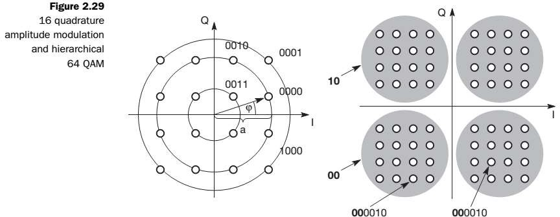
2.6. Modulation
A more advanced scheme is a hierarchical modulation as used in the digital TV standard DVB-T.
The right side of Figure 2.29 shows a 64 QAM that contains a QPSK modulation.

Slide 70
2.6. Modulation
A 64 QAM can code 6 bit per symbol.
Here the two most significant bits are used for the QPSK signal
embedded in the QAM signal.
If the reception of the signal is good the entire QAM constellation can be resolved.
Under poor reception conditions, e.g., with moving receivers, only
the QPSK portion can be resolved.
A high priority data stream in DVB-T is coded with QPSK using the two most significant bits.
The remaining 4 bits represent low priority data.
For TV this could mean that the standard resolution data stream is coded with high priority, the high resolution information with low priority.
If the signal is distorted, at least the standard TV resolution can
be received.

Slide 71
2.6. Modulation
2.6.6. Multi-carrier modulation
Specialmodulationschemesthatstandsomewhatapartfromthe others are,
multi-carrier modulation (MCM),
orthogonal frequency division multiplexing (OFDM) or
coded OFDM (COFDM) that are
used in the context of the European digital radio system DAB and the WLAN standards IEEE 802.11a and HiperLAN2.
The main attraction of MCM is its good ISI mitigation property.
Higher bit rates are more vulnerable to ISI.
MCM splits the high bit rate stream into many lower bit rate streams, each stream being sent using an independent carrier frequency.

Slide 72
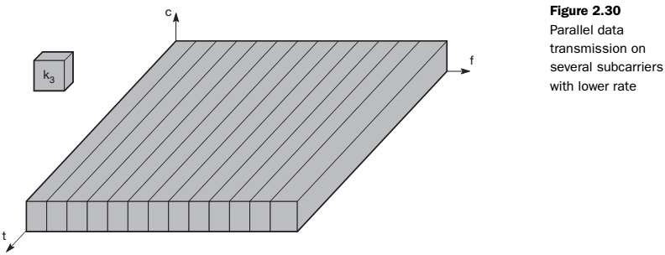
2.6. Modulation
If, for example, n symbols/s have to be transmitted, each subcarrier
transmits n/c symbols/s with c being the number of subcarriers.

Slide 73
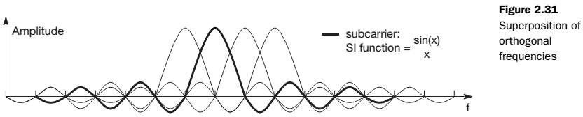
2.6. Modulation
Figure 2.31 shows the superposition of orthogonal frequencies.
Themaximumofonesubcarrierfrequencyappearsexactlyata
frequency where all other subcarriers equal zero.
Using this scheme, frequency selective fading only influences some subcarriers, and not the whole signal – an additional benefit of MCM.
Typically, MCM transmits symbols with guard spaces between single symbols or groups of symbols.
This helps the receiver to handle multi-path propagation.

Slide 74
2.6. Modulation
OFDM is a special method of implementing MCM using orthogonal
carriers.
Computationally,thisisaveryefficientalgorithmbasedonfast Fourier transform (FFT) for modulation/demodulation.
Ifadditionalerror-controlcodingacrossthesymbolsindifferent
subcarriers is applied, the system is referred to as COFDM.

Slide 75
2.7. Spread Spectrum
Spread spectrum techniques involve spreading the bandwidth
needed to transmit data.
Spreading the bandwidth has several advantages.
– The main advantage is the resistance to narrowband interference.
In Figure 2.32, diagram i) shows an idealized narrowband signal from a sender of user data (here power density dP/df versus frequency f).
The sender now spreads the signal in step ii), i.e., converts the narrowband signal into a broadband signal.
The energy needed to transmit the signal (the area shown in the diagram) is the same, but it is now spread over a larger frequency range.
The power level of the spread signal can be much lower than that of
the original narrowband signal without losing data.

Slide 76
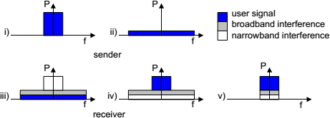
2.7. Spread Spectrum

Slide 77
2.7. Spread Spectrum
During transmission, narrowband and broadband interference add to
the signal in step iii).
The sum of interference and user signal is received.
The receiver now knows how to despread the signal, converting the spread user signal into a narrowband signal again, while spreading the narrowband interference and leaving the broadband interference.
In step v) the receiver applies a bandpass filter to cut off frequencies left and right of the narrowband signal.
Finally, the receiver can reconstruct the original data because the power level of the user signal is high enough, i.e., the signal is much stronger than the remaining interference.

Slide 78
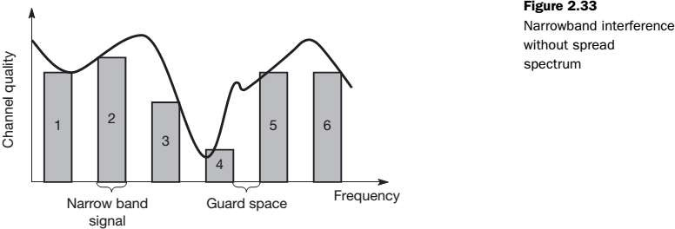
2.7. Spread Spectrum
Just as spread spectrum helps to deal with narrowband interference
for a single channel, it can be used for several channels.
Consider the situation shown in Figure 2.33. Six different channels use FDM for multiplexing, which means that each channel has its own narrow frequency band for transmission.
Betweeneachfrequencybandaguardspaceisneededtoavoid
adjacent channel interference.

Slide 79
2.7. Spread Spectrum
Channel quality is frequency dependent and is a measure for
interference at this frequency.
Channel quality also changes over time.
Depending on receiver characteristics, channels 1, 2, 5, and 6 could be received while the quality of channels 3 and 4 is too bad to reconstruct transmitted data.
Narrowband interference destroys the transmission of channels 3 and 4.
How can spread spectrum help in such a situation?
spread spectrum can increase resistance to narrowband interference.
The same technique is now applied to all narrowband signals.

Slide 80
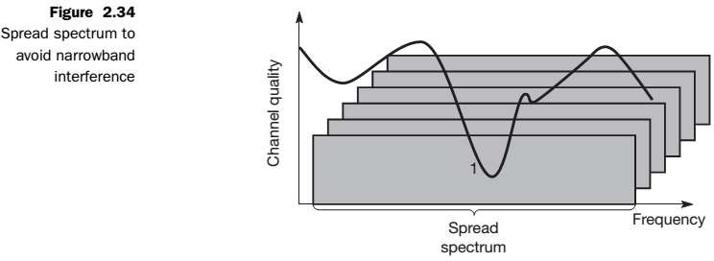
2.7. Spread Spectrum
All narrowband signals are now spread into broadband signals using
the same frequency range.
No more frequency planning is needed, and all senders use the same frequency band.

Slide 81
2.7. Spread Spectrum
How can receivers recover their signal?
To separate different channels, CDM is now used instead of FDM.
Spreadingofanarrowbandsignalisachievedusingaspecial code.
Each channel is allotted its own code, which the receivers have to
apply to recover the signal.
Without knowing the code, the signal cannot be recovered and behaves like background noise.
FeaturesthatmakespreadspectrumandCDMveryattractivefor
military applications.
One disadvantage is the increased complexity of receivers that have to despread a signal.
Another problem is the large frequency band that is needed due to the
spreading of the signal.

Slide 82
2.7. Spread Spectrum
Spreading the spectrum can be achieved in two different ways.
Direct sequence spread spectrum
Frequency hopping spread spectrum
2.7.1. Direct sequence spread spectrum
Direct sequence spread spectrum (DSSS) systems take a user bit stream and perform an XOR with a so-called chipping sequence.
The example shows that the result is either
the sequence 0110101 (if the user bit equals 0) or
its complement 1001010 (if the user bit equals 1).

Slide 83
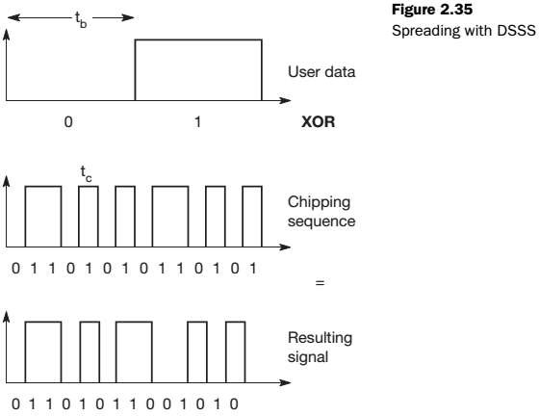
2.7. Spread Spectrum

Slide 84
2.7. Spread Spectrum
While each user bit has a duration t_{b}, the chipping sequence consists
of smaller pulses, called chips, with a duration t_{c}.
If the chipping sequence is generated properly it appears as random noise : this sequence is also sometimes called pseudo-noise sequence.
The spreading factor s = t_{b} / t_{c} determines the bandwidth of the resulting signal.
If the original signal needs a bandwidth w, the resulting signal needs
s·w after spreading.
The spreading factor of the very simple example is only 7 (and the chipping sequence 0110101 is not very random).

Slide 85
2.7. Spread Spectrum
Civil applications use spreading factors between 10 and 100,
Military applications use factors of up to 10,000.
Wireless LANs complying with the standard IEEE 802.11 use, for example, the sequence 10110111000, a so-called Barker code, if implemented using DSSS.
Barker codes exhibit a good robustness against interference and insensitivity to multi-path propagation.
Other known Barker codes are 11, 110, 1110, 11101, 1110010, and
1111100110101.

Slide 86
2.7. Spread Spectrum
Transmitters and Receivers using DSSS need additional components.
The first step in a DSSS transmitter, Figure 2.36 is the spreading of the user data with the chipping sequence (digital modulation).
The spread signal is then modulated with a radio carrier (radio modulation).
Assuming for example a user signal with a bandwidth of 1 MHz. Spreading with the above 11-chip Barker code would result in a signal with 11 MHz bandwidth.
The radio carrier then shifts this signal to the carrier frequency (e.g.,
2.4 GHz in the ISM band).
This signal is then transmitted.

Slide 87
2.7. Spread Spectrum
The DSSS receiver is more complex than the transmitter.
The receiver only has to perform the inverse functions of the two transmitter modulation steps.
However,noiseandmulti-pathpropagationrequireadditional
mechanisms to reconstruct the original data.
The first step in the receiver involves demodulating the received signal.
This is achieved using the same carrier as the transmitter reversing the modulation and results in a signal with approximately the same bandwidth as the original spread spectrum signal.
Additional filtering can be applied to generate this signal.

Slide 88
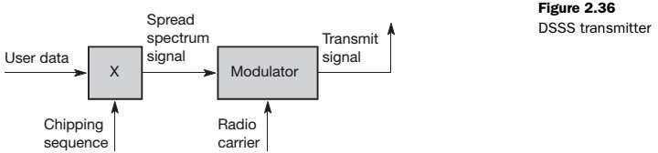
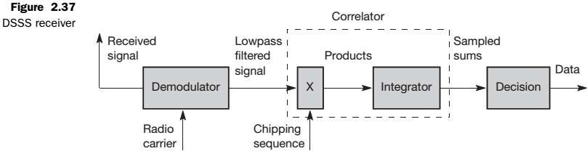
2.7. Spread Spectrum

Slide 89
2.7. Spread Spectrum
The receiver has to know the original chipping sequence, i.e., the receiver basically generates the same pseudo random sequence as the transmitter.
Sequences at the sender and receiver have to be precisely synchronized because the receiver calculates the product of a chip with the incoming signal.
This comprises another XOR operation, together with a medium access mechanism that relies on this scheme.
During a bit period, which also has to be derived via
synchronization, an integrator adds all these products.
Calculating the products of chips and signal, and adding the products in an integrator is also called correlation, the device a correlator.

Slide 90
2.7. Spread Spectrum
Finally,ineach | bitperiodadecision | unitsamplesthesums
generatedbythe | integratoranddecides | ifthissumrepresentsa
binary 1 or a 0.
Example :
Sending the user data 01 and applying the 11-chip Barker code 10110111000 results in the spread ‘signal’ 1011011100001001000111.
On the receiver side, this ‘signal’ is XORed bit-wise after demodulation with the same Barker code as chipping sequence.
This results in the sum of products equal to 0 for the first bit and to 11 for the second bit.
The decision unit can now map the first sum (=0) to a binary 0, the second sum (=11) to a binary 1 – this constitutes the original user data.

Slide 91
2.7. Spread Spectrum
The different paths may have different path losses.
Inthiscase,usingso-calledrakereceiversprovidesapossible solution.
A rake receiver uses n correlators for the n strongest paths.
Each correlator is synchronized to the transmitter plus the delay on
that specific path.
As soon as the receiver detects a new path which is stronger than the currently weakest path, it assigns this new path to the correlator with the weakest path.
The output of the correlators are then combined and fed into the decision unit.

Slide 92
2.7. Spread Spectrum
2.7.2. Frequency hopping spread spectrum
For frequency hopping spread spectrum (FHSS) systems, the total available bandwidth is split into many channels of smaller bandwidth plus guard spaces between the channels.
Transmitter and receiver stay on one of these channels for a certain
time and then hop to another channel.
This system implements FDM and TDM.
The pattern of channel usage is called the hopping sequence, the time spend on a channel with a certain frequency is called the dwell time.
FHSS comes in two variants, slow and fast hopping.

Slide 93
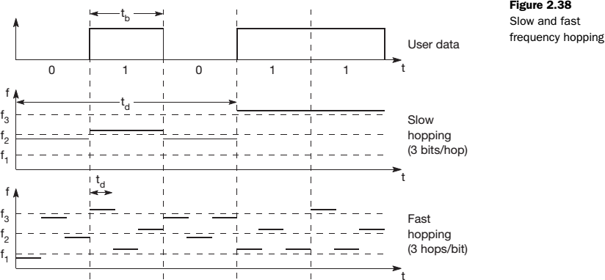
2.7. Spread Spectrum

Slide 94
2.7. Spread Spectrum
In slow hopping, the transmitter uses one frequency for several bit
periods.
Figure 2.38 shows five user bits with a bit period t_{b}.
Performing slow hopping, the transmitter uses the frequency f₂ for
transmitting the first three bits during the dwell time t_{d}.
Then, the transmitter hops to the next frequency f₃ .
Slow hopping systems are typically cheaper and have relaxed tolerances, but they are not as immune to narrowband interference as fast hopping systems.
Slow frequency hopping is an option for GSM.

Slide 95
2.7. Spread Spectrum
For fast hopping systems, the transmitter changes the frequency
several times during the transmission of a single bit.
In the example of Figure 2.38, the transmitter hops three times during a bit period.
Fast hopping systems are more complex to implement because the transmitter and receiver have to stay synchronized within smaller tolerances to perform hopping at more or less the same points in time.
However, these systems are much better at overcoming the effects of narrowband interference and frequency selective fading as they only stick to one frequency for a very short time.
Another example of an FHSS system is Bluetooth.
Bluetooth performs 1,600 hops per second and uses 79 hop carriers
equally spaced with 1 MHz in the 2.4 GHz ISM band.

Slide 96
2.7. Spread Spectrum
The first step in an FHSS transmitter is the modulation of user data according to one of the digital-to-analog modulation schemes, e.g., FSK or BPSK.
This results in a narrowband signal, if FSK is used with a frequency
f₀ for a binary 0 and
f₁ for a binary 1.
Inthenextstep,frequencyhoppingisperformed,basedona hopping sequence.
The hopping sequence is fed into a frequency synthesizer generating
the carrier frequencies f_{i}.
A second modulation uses the modulated narrowband signal and the carrier frequency to generate a new spread signal with frequency of
f_{i} + f₀ for a 0 and
f_{i} + f₁ for a 1 respectively.

Slide 97
2.7. Spread Spectrum
If different FHSS transmitters use hopping sequences that never overlap, i.e., if two transmitters never use the same frequency f_{i} at the same time, then these two transmissions do not interfere.
This requires the coordination of all transmitters and their hopping
sequences.
As for DSSS systems, pseudo-random hopping sequences can also be used without coordination.
Thesesequencesonlyhavetofulfillcertainpropertiestokeep
interference minimal.
Two or more transmitters may choose the same frequency for a hop, but dwell time is short for fast hopping systems, so interference is minimal.

Slide 98
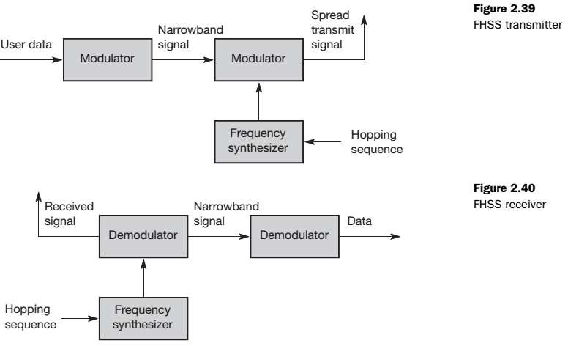
2.7. Spread Spectrum

Slide 99
2.7. Spread Spectrum
The receiver of an FHSS system has to know the hopping sequence
and must stay synchronized.
Itthenperformstheinverseoperationsofthemodulationto reconstruct user data.
Compared to DSSS, spreading is simpler using FHSS systems.
FHSS systems only use a portion of the total band at any time, while DSSS systems always use the total bandwidth available.
DSSS systems on the other hand are more resistant to fading and multi-path effects.
DSSSsignalsaremuchhardertodetect–withoutknowingthe spreading code, detection is virtually impossible.
Ifeachsenderhasitsownpseudo-randomnumbersequencefor spreading the signal (DSSS or FHSS), the system implements CDM.

Slide 100
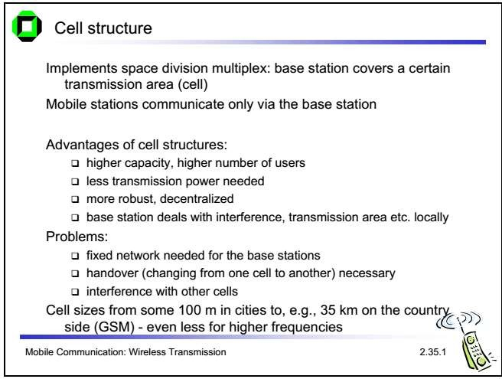
2.8. Cellular systems

Slide 101
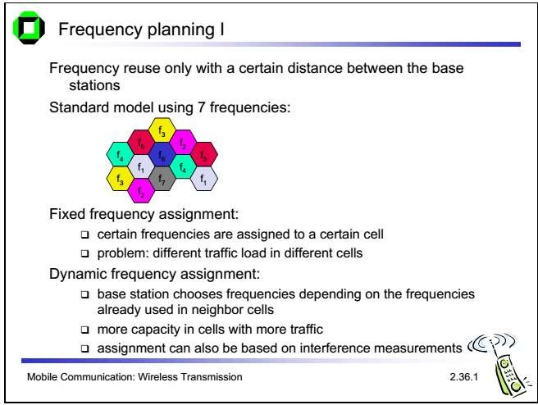
2.8. Cellular systems

Slide 102
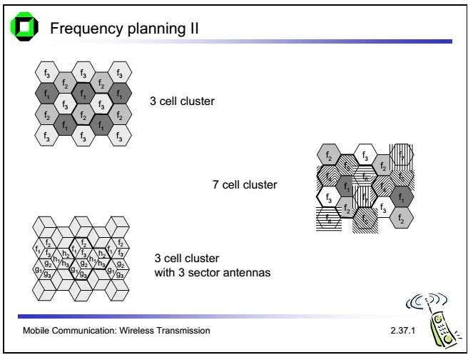
2.8. Cellular systems

